Slide 1
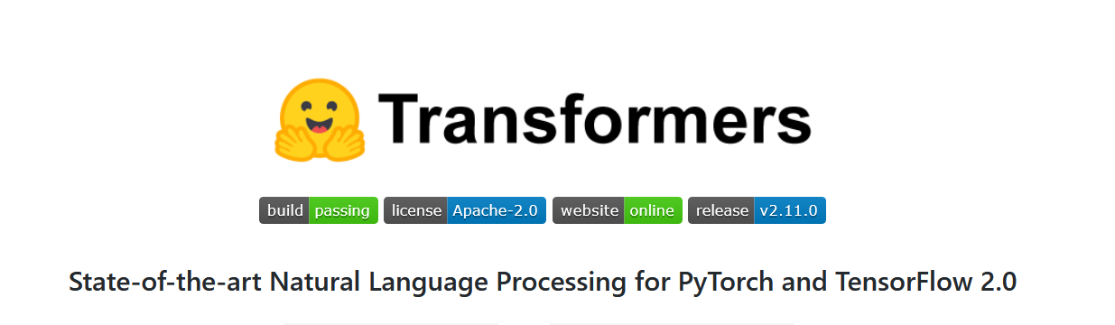
HuggingFace’s Transformers library
Matteo Paganelli
matteo.paganelli@unimore.it

Slide 2
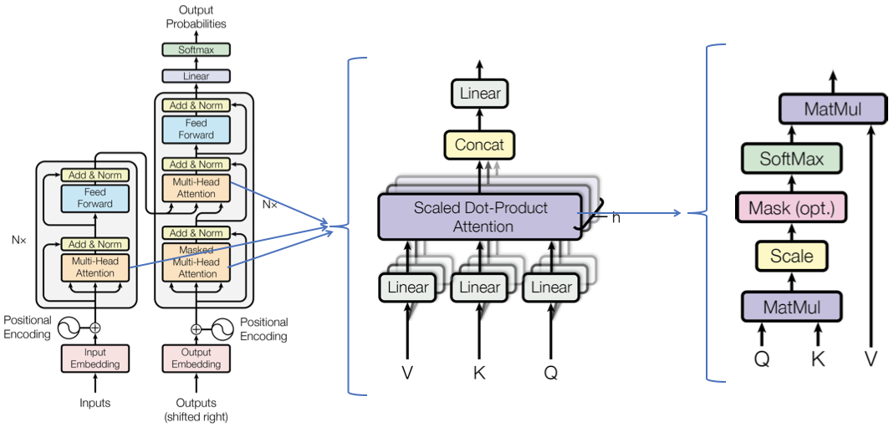
The goal of 🤗 Transformers library is to provide a single API through which any Transformer model can be loaded, trained, and saved.

Slide 3
NLP Tasks
Classifying whole sentences: Getting the sentiment of a review, detecting if an email is spam, determining if a sentence is grammatically correct or whether two sentences are logically related or not
Classifying each word in a sentence: Identifying the grammatical components of a sentence (noun, verb, adjective), or the named entities (person, location, organization)
Generating text content: Completing a prompt with auto-generated text, filling in the blanks in a text with masked words
Extracting an answer from a text: Given a question and a context, extracting the answer to the question based on the information provided in the context
Generating a new sentence from an input text: Translating a text into another language, summarizing a text

Slide 4
Pipelines
It connects a model with its necessary preprocessing and postprocessing steps, allowing us to directly input any text and get an intelligible answer
feature-extraction (get the vector representation of a text)
fill-mask
ner (named entity recognition)
question-answering
sentiment-analysis
summarization
text-generation
translation
zero-shot-classification
https://huggingface.co/docs/transformers/main_classes/pipelines

Slide 5
Sentiment Analysis
from transformers import pipeline
classifier = pipeline("sentiment-analysis")
classifier("I've been waiting for a HuggingFace course my whole life.")
[{'label': 'POSITIVE', 'score': 0.9598047137260437}]

Slide 6
Zero-shot classification
It allows you to specify which labels to use for the classification, so you don’t have to rely on the labels of the pretrained model.
from transformers import pipeline
classifier = pipeline("zero-shot-classification")
classifier(
"This is a course about the Transformers library",
candidate_labels=["education", "politics", "business"],
)
{'sequence': 'This is a course about the Transformers library',
'labels': ['education', 'business', 'politics'], 'scores': [0.844, 0.112, 0.0434]}

Slide 7
Text generation
You provide a prompt and the model will auto-complete it by generating the remaining text
from transformers import pipeline
generator = pipeline("text-generation")
generator("In this course, we will teach you how to")
[{'generated_text': 'In this course, we will teach you how to understand and use data flow and data interchange when handling user data. We will be working with one or more of the most commonly used data flows — data flows of various types, as seen by the 'HTTP'}]

Slide 8
Using any model from the Hub in a pipeline
The previous examples used the default model for the task at hand, but you can also choose a particular model from the Model Hub
from transformers import pipeline
generator = pipeline("text-generation", model="distilgpt2")
generator(
"In this course, we will teach you how to",
max_length=30, num_return_sequences=2,
)

Slide 9
Mask filling
The idea of this task is to fill in the blanks in a given text
from transformers import pipeline
unmasker = pipeline("fill-mask")
unmasker("This course will teach you all about <mask> models.", top_k=2)
[{'sequence': 'This course will teach you all about mathematical models.', 'score': 0.19619831442832947, 'token': 30412, 'token_str': ' mathematical'}, {'sequence': 'This course will teach you all about computational models.', 'score': 0.04052725434303284, 'token': 38163, 'token_str': ' computational'}]

Slide 10
Named entity recognition
Named entity recognition (NER) is a task where the model has to find which parts of the input text correspond to entities such as persons, locations, or organizations.
from transformers import pipeline
ner = pipeline("ner", grouped_entities=True)
ner("My name is Sylvain and I work at Hugging Face in Brooklyn.")
[{'entity_group': 'PER', 'score': 0.99816, 'word': 'Sylvain', 'start': 11, 'end': 18}, {'entity_group': 'ORG', 'score': 0.97960, 'word': 'Hugging Face', 'start': 33, 'end': 45}, {'entity_group': 'LOC', 'score': 0.99321, 'word': 'Brooklyn', 'start': 49, 'end': 57}]

Slide 11
Question answering
The question-answering pipeline answers questions using information from a given context
from transformers import pipeline
question_answerer = pipeline("question-answering")
question_answerer(
question="Where do I work?",
context="My name is Sylvain and I work at Hugging Face in Brooklyn",
)
{'score': 0.6385916471481323, 'start': 33, 'end': 45, 'answer': 'Hugging Face'}

Slide 12
Summarization
Summarization is the task of reducing a text into a shorter text while keeping all (or most) of the important aspects referenced in the text.
from transformers import pipeline
summarizer = pipeline("summarization")
summarizer( """ America has changed dramatically during recent years. Not only has the number of graduates in traditional engineering disciplines such as mechanical, civil, electrical, chemical, and aeronautical engineering declined, but in most of the premier American universities engineering curricula now concentrate on and encourage largely the study of engineering science. As a result, there are declining offerings in engineering subjects dealing with infrastructure, the environment, and related issues, and greater concentration on high technology subjects, largely supporting increasingly complex scientific developments. While the latter is important, it should not be at the expense of more traditional engineering. """ )
[{'summary_text': ' America has changed dramatically during recent years . The number of engineering graduates in the U.S. has declined in traditional engineering disciplines such as mechanical, civil, electrical, chemical, and aeronautical engineering . Rapidly developing economies such as China and India, as well as other industrial countries in Europe and Asia, continue to encourage and advance engineering .'}]

Slide 13
Translation
from transformers import pipeline
translator = pipeline("translation", model="Helsinki-NLP/opus-mt-fr-en")
translator("Ce cours est produit par Hugging Face.")
[{'translation_text': 'This course is produced by Hugging Face.'}]

Slide 14
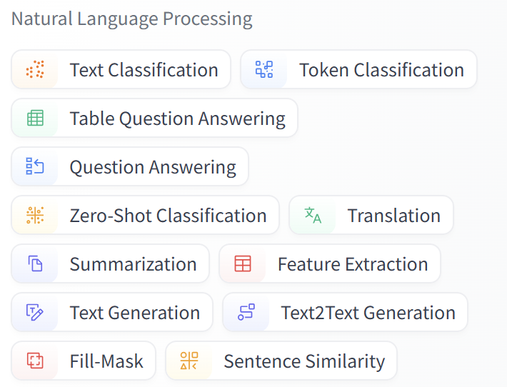
Models and Datasets available
Models: https://huggingface.co/models
Datasets: https://huggingface.co/datasets

Slide 15
Main concepts

Slide 16
Example
from transformers import pipeline
classifier = pipeline("sentiment-analysis")
classifier(
[
"I've been waiting for a HuggingFace course my whole life.",
"I hate this so much!",
]
)

Slide 17
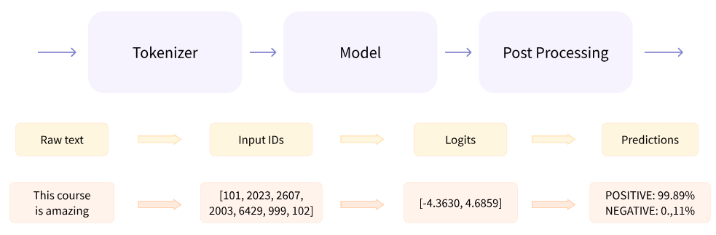
Behind a pipeline

Slide 18
Tokenizer (1)
The tokenizer is responsible for:
Splitting the input into words, subwords, or symbols (like punctuation) that are called tokens
Mapping each token to an integer
Adding additional inputs that may be useful to the model
All this preprocessing needs to be done in exactly the same way as when the model was pretrained

Slide 19
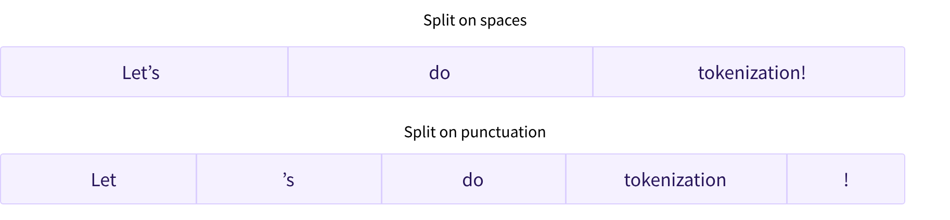
Tokenizer (2)
Word-based
  Large vocabulary
  Many OOV tokens
Character-based
  Vocabulary is smaller
  Fewer OOV tokens
Subword-based
  Good coverage with small vocabularies
  Close to no unknown tokens
  WordPiece (BERT)
    'granola bars' -> 'gran', '##ola', 'bars', where ## indicates the start of the substring.

Slide 20
Tokenizer (3)
from transformers import AutoTokenizer
checkpoint = "distilbert-base-uncased-finetuned-sst-2-english"
tokenizer = AutoTokenizer.from_pretrained(checkpoint)
raw_inputs = [ "I've been waiting for a HuggingFace course my whole life.", "I hate this so much!", ]
inputs = tokenizer(raw_inputs, padding=True, truncation=True, return_tensors="pt")
{ 'input_ids': tensor([ [ 101, 1045, 1005, 2310, 2042, 3403, 2005, 1037, 17662, 12172, 2607, 2026, 2878, 2166, 1012, 102], [ 101, 1045, 5223, 2023, 2061, 2172, 999, 102, 0, 0, 0, 0, 0, 0, 0, 0] ]),
'attention_mask': tensor([ [1, 1, 1, 1, 1, 1, 1, 1, 1, 1, 1, 1, 1, 1, 1, 1], [1, 1, 1, 1, 1, 1, 1, 1, 0, 0, 0, 0, 0, 0, 0, 0] ]) }

Slide 21
Tokenizer (4)
Padding makes sure all our sentences have the same length by adding a special word called the padding token to the sentences with fewer values.
  The padding token ID can be found in tokenizer.pad_token_id
Attention masks are tensors with the exact same shape as the input IDs tensor, filled with 0s and 1s: 1s indicate the corresponding tokens should be attended to, and 0s indicate the corresponding tokens should not be attended to (i.e., they should be ignored by the attention layers of the model).
With Transformer models, there is a limit to the lengths of the sequences we can pass the models (e.g., 512 or 1024 tokens)
  Use a model with a longer supported sequence length.
  Truncate your sequences.

Slide 22
Tokenizer (3)
from transformers import AutoTokenizer
checkpoint = "distilbert-base-uncased-finetuned-sst-2-english"
tokenizer = AutoTokenizer.from_pretrained(checkpoint)
raw_inputs = [ "I've been waiting for a HuggingFace course my whole life.", "I hate this so much!", ]
inputs = tokenizer(raw_inputs, padding=True, truncation=True, return_tensors="pt")
{ 'input_ids': tensor([ [ 101, 1045, 1005, 2310, 2042, 3403, 2005, 1037, 17662, 12172, 2607, 2026, 2878, 2166, 1012, 102], [ 101, 1045, 5223, 2023, 2061, 2172, 999, 102, 0, 0, 0, 0, 0, 0, 0, 0] ]),
'attention_mask': tensor([ [1, 1, 1, 1, 1, 1, 1, 1, 1, 1, 1, 1, 1, 1, 1, 1], [1, 1, 1, 1, 1, 1, 1, 1, 0, 0, 0, 0, 0, 0, 0, 0] ]) }
Special tokens

Slide 23
Model (1)
from transformers import AutoModel
checkpoint = "distilbert-base-uncased-finetuned-sst-2-english"
model = AutoModel.from_pretrained(checkpoint)
This architecture contains only the base Transformer module: given some inputs, it outputs what we’ll call hidden states, also known as features. For each model input, we’ll retrieve a high-dimensional vector representing the contextual understanding of that input by the Transformer model.

Slide 24
Model (2)
outputs = model(**inputs)
print(outputs.last_hidden_state.shape)
torch.Size([2, 16, 768])
Batch size: The number of sequences processed at a time (2 in our example).
Sequence length: The length of the numerical representation of the sequence (16 in our example).
Hidden size: The vector dimension of each model input.

Slide 25
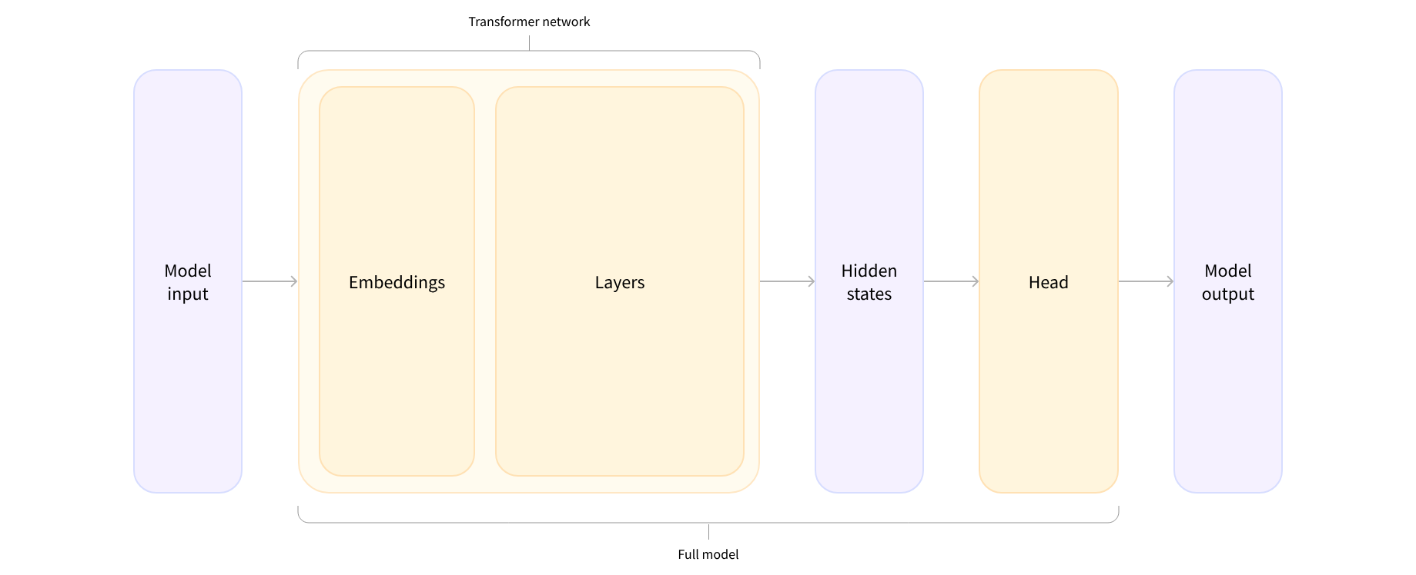
Model (3)
While these hidden states can be useful on their own, they’re usually inputs to another part of the model, known as the head
*Model (retrieve the hidden states)
*ForCausalLM
*ForMaskedLM
*ForMultipleChoice
*ForQuestionAnswering
*ForSequenceClassification
*ForTokenClassification

Slide 26
Model (4)
To be able to classify the sentences as positive or negative we need a model with a sequence classification head
from transformers import AutoModelForSequenceClassification
checkpoint = "distilbert-base-uncased-finetuned-sst-2-english"
model = AutoModelForSequenceClassification.from_pretrained(checkpoint)
outputs = model(**inputs)
print(outputs.logits)
tensor([[-1.5607, 1.6123], [ 4.1692, -3.3464]])

Slide 27
Model (5)
Our model predicted [-1.5607, 1.6123] for the first sentence and [ 4.1692, -3.3464] for the second one. Those are not probabilities but logits, the raw, unnormalized scores outputted by the last layer of the model. To be converted to probabilities, they need to go through a SoftMax layer
import torch
predictions = torch.nn.functional.softmax(outputs.logits, dim=-1)
Now we can see that the model predicted [0.0402, 0.9598] for the first sentence and [0.9995, 0.0005] for the second one. These are recognizable probability scores.

Slide 28
References
HuggingFace course: https://huggingface.co/course
Transformer architecture implemented from scratch: https://github.com/aladdinpersson/Machine-Learning-Collection/blob/master/ML/Pytorch/more_advanced/transformer_from_scratch/transformer_from_scratch.py
Explanation of the Transformer architecture and derived models
  https://jalammar.github.io/illustrated-transformer/
  https://jalammar.github.io/illustrated-gpt2/

Slide 29
Bonus

Slide 30
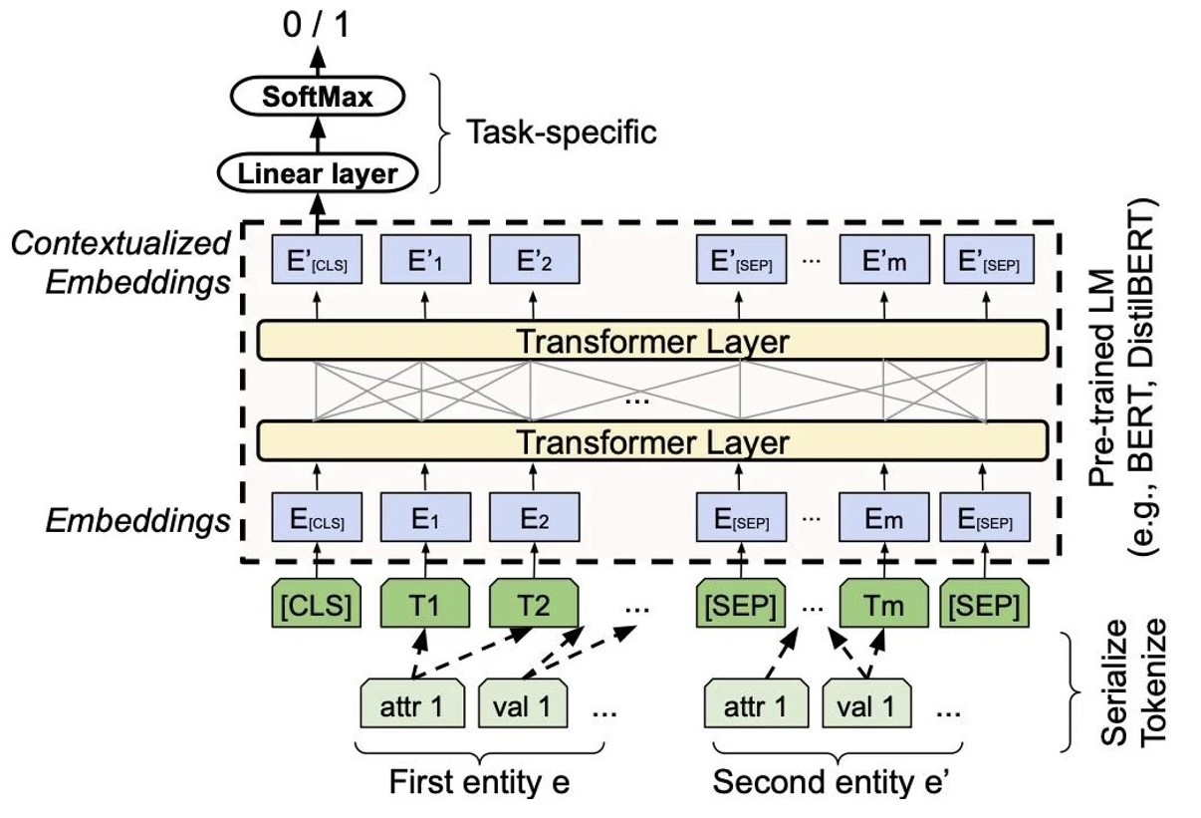
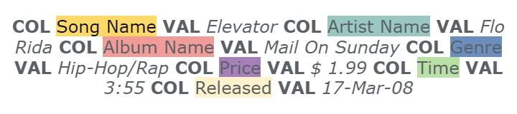
Deep Entity Matching with Pre-Trained Language Models
A pre-trained language model adapted to the EM task
  A binary classifier added on top of the CLS token embedding
Optimizations (mainly in the data)
  Attribute separators
  Domain knowledge injection
  TF-IDF summarization
https://www.vldb.org/pvldb/vol14/p50-li.pdf

